Slide 1
GOLANG-NATIVE AGENTIC PLATFORM ENGINEERING WITH EMBEDDED MCP
Presenter: Jeffrey Aven
STACKQL>>
Notes:
Three things today:
StackQL in five minutes
what changes when agents write to your estate
and how to embed the MCP server in a Golang binary

Slide 2
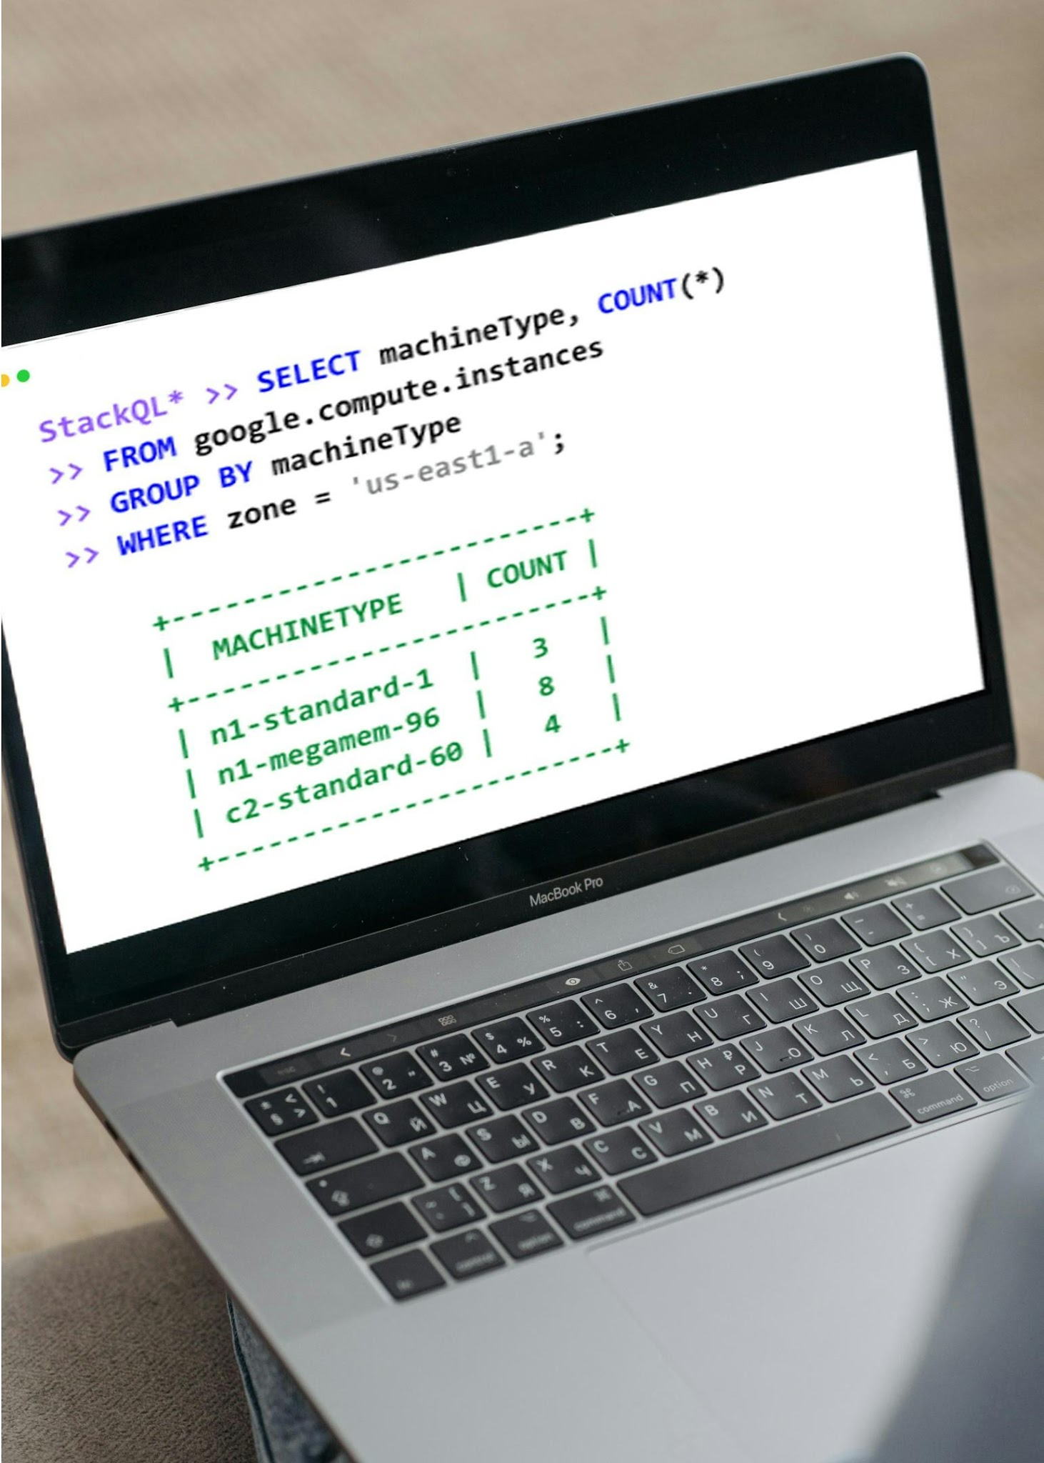


STACKQL >>
Unified Cross-Plane Analytics, Automation and IaC
Query and Interact in Real
Time using SQL
Seamless Integration with
Existing Systems
Analyst Friendly, Agent Native
CONFIGURATION-AS-DATA
INFRASTRUCTURE-AS-CONTEXT
STACKQL>>
Notes:
Cloud and SaaS providers as data sources accessed via SQL.
Query and change live state.
No server, no database, no state file: the engine calls the provider APIs at query time.

Slide 3

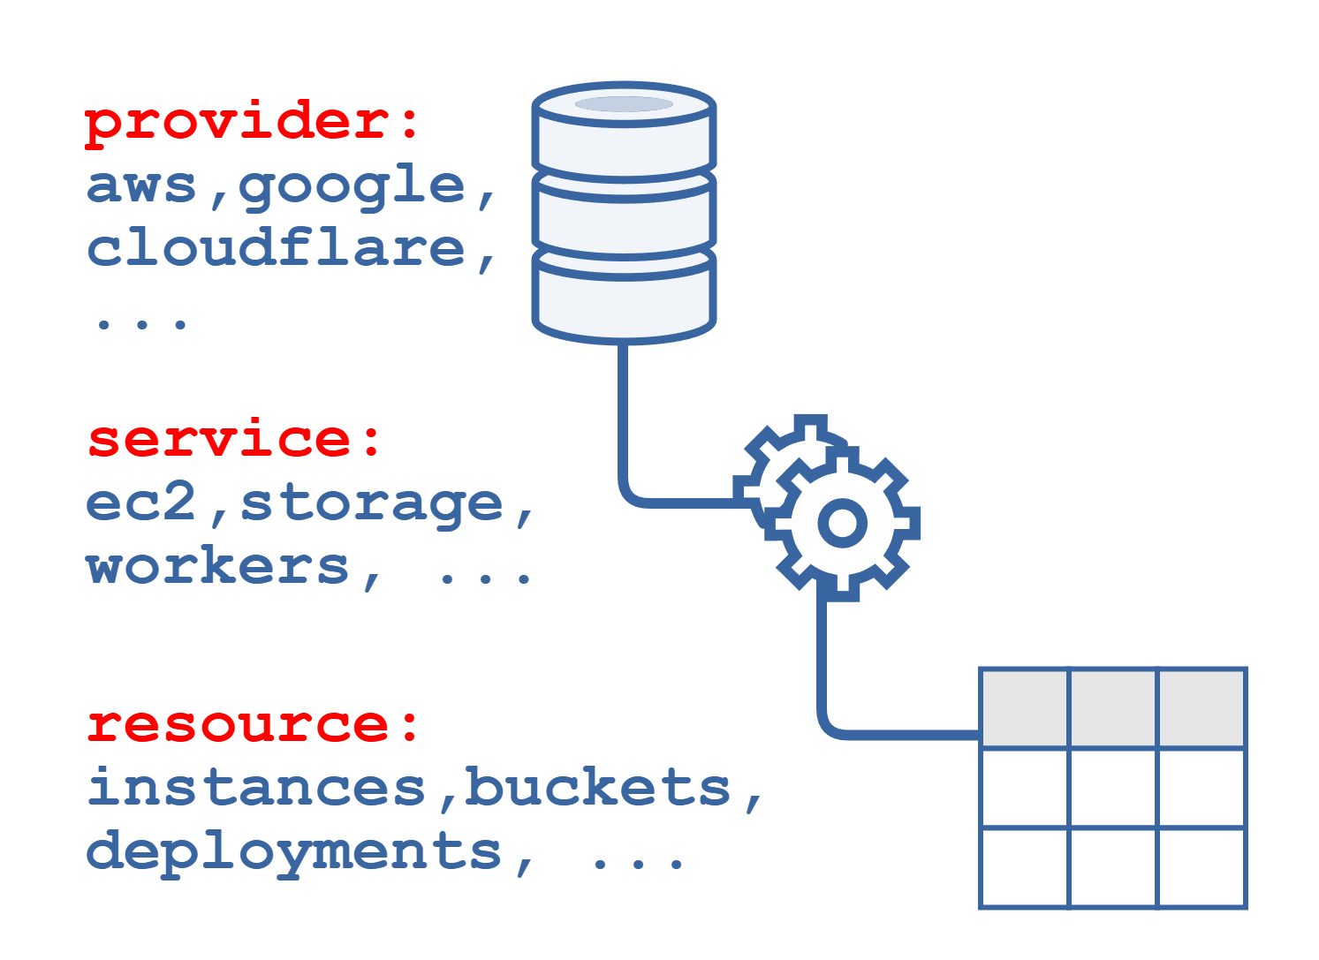
Cloud Providers as Data Sources
Open-Source intelligent API client
Protocol Agnostic
DAG planning for remote and local execution
SQL semantics for Cloud/SaaS Provider APIs
Relational algebra, analytics
CRUD, Discovery and Lifecycle Methods
STACKQL>>
Notes:
Providers are OpenAPI-derived interface documents pulled from a registry; 40+ providers, community extensible.
SELECT for reads, INSERT/UPDATE/REPLACE/DELETE for writes, EXEC for lifecycle methods.
The planner builds a DAG: remote calls where it must, local relational work (joins, aggregates, SQLite functions) where it can.

Slide 4




How to use StackQL
One execution engine. Multiple human/agent consumption patterns.
PATTERN |  | INTERFACE | USERS | KEY BENEFIT
 | Interactive Analytics | stackql shell stackql exec | Engineers, Analysts | Ad-hoc discovery, inventory
 | Application & Data Integration | stackql srv docker pull pystackql | Apps, BI Tools, Python Workloads | Application access to Cloud and SaaS APIs
 | Platform Automation | stackql-deploy Marketplace GitHub Actions | Platform & DevOps Teams | Declarative automation and IaC
 | Agentic Operations | MCP (uv, pip, npx, docker, mcpb) | AI Agents & Agent Frameworks | Context-aware cloud operations
STACKQL>>

Slide 5
AGENTIC PLATFORM OPS
Platform Engineering, XOps, and SRE in the Agent Era
STACKQL>>
Notes:
why does any of this matter for platform engineering, SRE, XOps?
Because agents are about to become writers to your estate, and the tooling assumes they are not.

Slide 6

IaC/PLATFORM OPS IN THE AGENT ERA
Agents AND humans
author changes.
Humans author the changes.
Changes at human timescales.
Changes at machine speed.
One writer per environment.
Multiple writers, at the same time.
Drift is an exception.
Drift is the default state.
STACKQL>>
Notes:
IaC was based upon four assumptions, all of which were reasonable ten years ago, now all inverted.
Humans authored the changes.
Changes happened at human timescales, which is to say minutes to days.
One writer per environment, enforced by review and state locking.
And drift was an exception, something you fixed and then went back to the steady state.
A state file is a snapshot of one writer's belief.
With multiple writers it is wrong by construction.

Slide 7
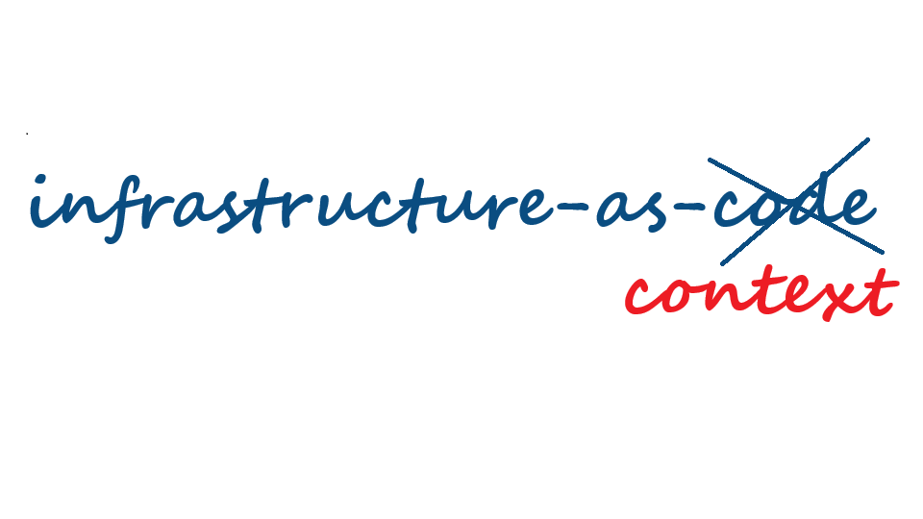
IaC IN THE AGENT ERA
STACKQL>>
Notes:
The agent's context has to be the running estate, not a plan file.

Slide 8
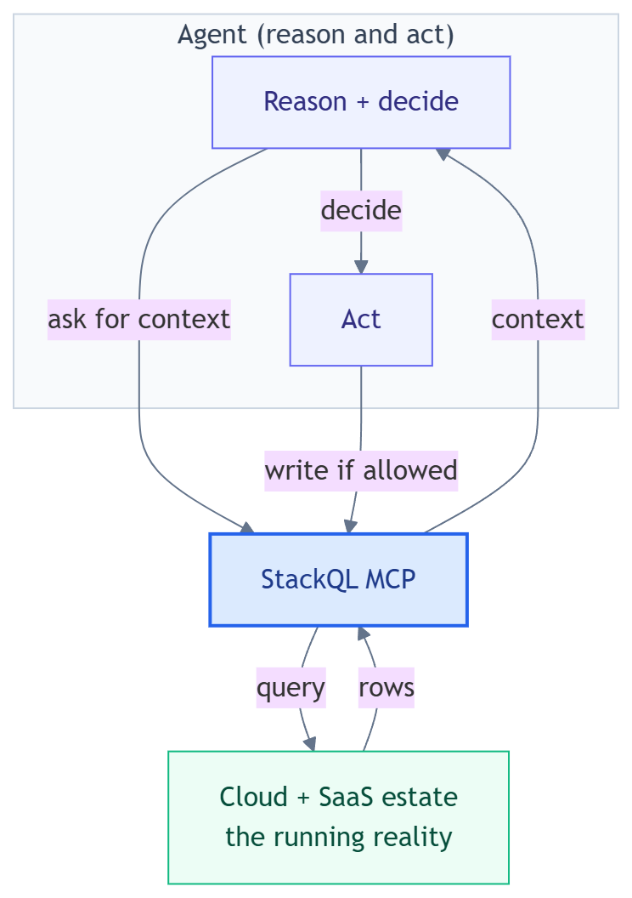
THE NEW CONTRACT
Agents need to query, reason about, and act on actual state.
Static state and state files are artefacts of slow infrastructure.
STACKQL>>
Notes:
with Infrastructure-as-Code: the intent lived in the code.
with Infrastructure-as-Context: agents need to query, reason about, and act on actual state.
Code does not disappear. It - along with the state file - just stops being the contract.

Slide 9
STACKQL MCP
The agent interface to the StackQL execution engine
STACKQL>>
Notes:
The agent interface to the engine. Same SQL, served over MCP.

Slide 10
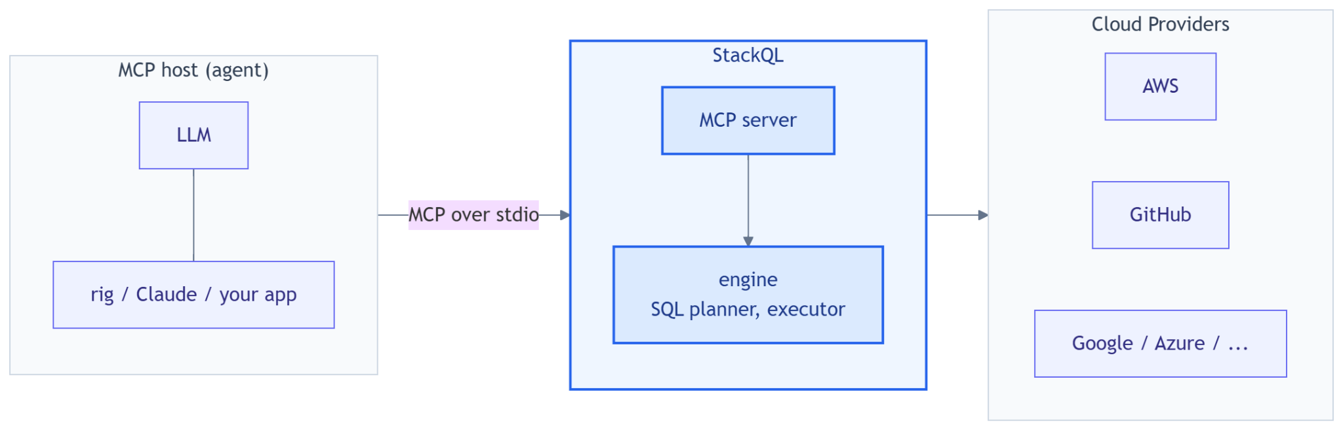
WHAT THE STACKQL MCP SERVER IS
Unified SQL surface over every cloud and SaaS provider.
STACKQL>>
Notes:
One MCP server, one SQL surface, every provider. Instead of N bespoke tool servers with N auth schemes.
Runs over stdio or HTTP; the host here is our own Rust app, but it is the same server Claude Desktop, Cursor, npx and uvx users run.
Credentials stay server-side in the process environment; the model never sees them.

Slide 11
STACKQL MCP TOOL SURFACE
One MCP, one set of tools, instead of 10s or 100s
Discovery: list_providers, list_services, list_resources, describe_resource, describe_method, list_methods, list_registry, pull_provider, server_info
Query (reads): run_select_query, validate_select_query
Change (writes): run_mutation_query, run_lifecycle_operation
changes gated through server modes: read_only (default), safe & delete_safe (uses elicitation), full_access
all tool use is logged by the stackql mcp server
STACKQL>>
Notes:
Discovery tools let the model drill provider -> service -> resource -> methods before writing SQL, so it does not guess table names.
Modes are a server-side contract: `read_only` refuses writes however the model is prompted; `safe` and `delete_safe` send an MCP elicitation request and wait for a human; a client that cannot answer gets a refusal. `full_access` is the explicit opt-in.
Every tool call is audited as JSONL (SQL, decision, duration; never result rows).

Slide 12
EMBEDDED MCP WITH GOLANG
MCP execution, embedded directly into Golang applications
STACKQL>>
Notes:
Normal MCP topology: a server you deploy and operate, clients connect to it.
Fine for shared capability, wrong for software you hand to someone else.
With embedded MCP the app owns the server lifecycle. Acquire, spawn as a child, handshake, hand back a client.
The server becomes an implementation detail.

Slide 13
SIDECAR VS VENDORED
Two ways to acquire the server.
 |  | Sidecar (default feature) | Vendored (vendored feature)
How the server arrives |  | downloaded at first run, for the release pinned in the module | fetched by go generate at build time, compiled in with go:embed
Integrity |  | sha256 checked against the pins shipped in the module | sha256 recorded at generate time, re-verified at run time
First run |  | download, verify, extract, cache | extract from the binary into the same cache, launch
Network at run time |  | first run only (releases.stackql.io) | never
Artefact size |  | the app | app + server binary (~100 MB)
Choose when |  | many apps on one host, one cached server | single-file distribution
STACKQL>>
Notes:
Same StartServer, same connected client, one field of difference: Options.Binary. You pick at build time.
Sidecar: the module ships sha256 pins rendered from the release (platforms.json); first run downloads that exact bundle from releases.stackql.io, verifies, extracts, caches under ~/.stackql/mcp-server-bin/<version>/<platform>/. The cache is shared with the npm and PyPI wrappers, so a polyglot host downloads once.
Vendored: go generate runs stackql-mcp-fetch, which downloads and pin-verifies the bundle, extracts the server binary and writes the go:embed glue; go build compiles it in. Nothing to download at run time, one file to ship. -platform all generates every supported platform behind build tags.
What is embedded is the extracted server binary, not the compressed bundle, so the vendored artefact is the app plus roughly 100 MB on linux and 130 MB on windows.

Slide 14
SIDECAR DETAILED
go get and one StartServer call to a connected MCP client.
what StartServer does...
# go.mod
require github.com/stackql/stackql-mcp-go v0.11.669 // = stackql release
// main.go
import stackqlmcp "github.com/stackql/stackql-mcp-go/embed"
func main() {
ctx := context.Background()
server, err := stackqlmcp.StartServer(ctx, stackqlmcp.Options{
Mode: stackqlmcp.ModeReadOnly, // writes refused server-side
}) // acquire, verify, spawn, handshake
if err != nil { log.Fatal(err) }
defer server.Close()
listed, _ := server.Session.ListTools(ctx, nil) // 16 StackQL tools
fmt.Println(len(listed.Tools), "tools, mode", server.Mode)
}
cached? ~/.stackql/mcp-server-bin/<ver>/<os>/
No
Yes
download .mcpb from releases.stackql.io, verify sha256 against the pin in the module
exec.Command + mcp.CommandTransport: spawn stackql mcp over stdio, MCP initialize
Client: a connected go-sdk ClientSession. ListTools(), CallTool(), Close()
STACKQL>>
Notes:
Cache check, download and verify on a miss, spawn stackql mcp over stdio, MCP initialize, and you get a go-sdk ClientSession back in Client.Session.
modelcontextprotocol/go-sdk is the official Go MCP SDK; mcp.CommandTransport drives the child's stdio. No async runtime to bring: the standard library and exec.Command do the work.
Escape hatches: STACKQL_MCP_BIN (run this binary), STACKQL_MCP_BUNDLE (extract this local .mcpb), Options.CacheDir, Options.AppRoot, Options.Auth (the github null_auth trick that makes the demos zero-credential).
ctx bounds the startup only; the Client outlives it and runs until Close.

Slide 15
VENDORED DETAILED
what
go generate ./cmd/vendored
does...
Same program, server compiled in
// main.go: one directive, run once at build time
//go:generate go run github.com/stackql/stackql-mcp-go/cmd/stackql-mcp-fetch -platform auto -package main
// stackql_mcp_linux_x64_gen.go: generated, gitignored, build-tagged
//go:build linux && amd64
//go:embed stackql-mcp-linux-x64
var stackqlMCPData []byte
func StackqlMCPBinary() stackqlmcp.Binary {
return stackqlmcp.Binary{Data: stackqlMCPData, Version: "0.11.669",
PlatformKey: "linux-x64", SHA256: "b78b70e2..."}
}
// main.go: identical to the sidecar program, plus one field
server, err := stackqlmcp.StartServer(ctx, stackqlmcp.Options{
Binary: StackqlMCPBinary(), // <- the only change
Mode: stackqlmcp.ModeReadOnly,
})
stackql-mcp-fetch downloads the .mcpb, verifies sha256 against the pin, extracts the server binary, writes the go:embed glue
go build compiles the bytes in: one binary, app + StackQL engine
extracted? ~/.stackql/mcp-server-bin/<ver>/<os>/ (sha256 re-checked)
no -> extract
yes
spawn stackql mcp over stdio, MCP initialize. Client: a connected go-sdk session
STACKQL>>
Notes:
go generate runs stackql-mcp-fetch once at build time: download, pin-verify, extract, and write a generated file with the go:embed directive and a StackqlMCPBinary() function that returns an embed.Binary (data, version, platform key, sha256). go:embed is a language feature; there is no build script to write.
The generated file and the binary are gitignored; CI regenerates them before building. -platform all produces one file per platform behind build tags, so a cross-compiled release carries the right server for each target.
First run extracts from the binary into the same shared cache, re-verifying the sha256, and starts. STACKQL_MCP_BIN and STACKQL_MCP_BUNDLE still take precedence at run time, which is how CI and custom builds swap the server without a rebuild.

Slide 16
DEMO
STACKQL>>

Slide 17



CLOUD
COMPLIANCE
SECURITY
MCP
AUTOMATION
ASSURANCE
THANK YOU
STACKQL>>
stackql.io

